Slide 1

Malware Incident Strategies
Jared Perry, GSEC
Memorial University

Slide 2

Historically
Malware more of a nuisance than anything
AV deployed with default policy, left to do its job
Large scale outbreaks occasionally occurred, but not often
Boxes that could not be disinfected were flattened and put back into service ASAP
Notes:
Malware more of a nuisance than anything else
* slower evolving, less insidious
Note the emphasis on returning individual machines to their owners as quickly as possible, much like any other break-fix

Slide 3
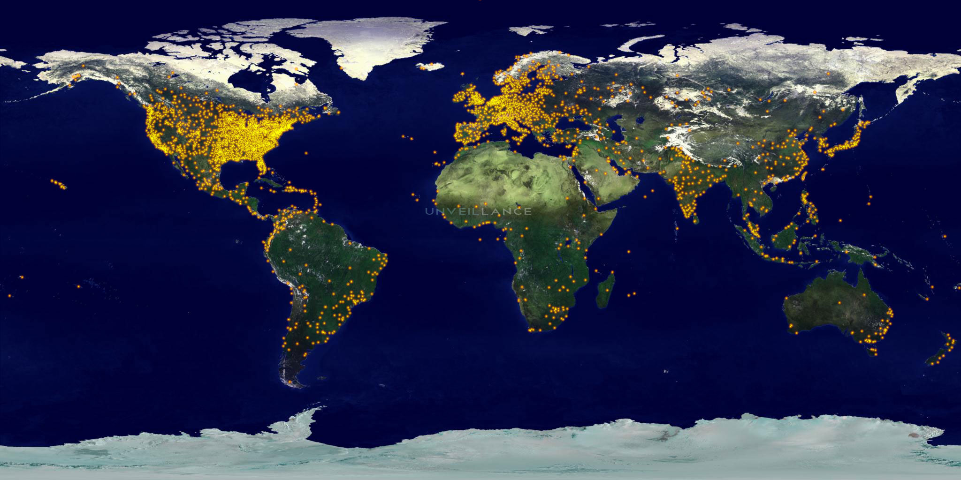
Every 1.4 seconds of every day, a new malware sample arrives.
--Sophos
In Q1 we have received an average of 195,463 files to analyze every day, 37.4% of which were new threats.
--PandaLabs
More than 20 million new pieces of malware appearing in 2010 means that we identify nearly 55,000 malware threats every day.
--McAfee
Notes:
Today we’re dealing with a very different landscape:
Crimeware, botnets no longer just about being a nuisance or for notoriety
Skyrocketing numbers
Plummeting detection rates among all AV vendors

Slide 4
Zeus
Our wakeup call
Keystroke logging Trojan
July 26, 2010 email from CCIRC
10 infections, IP addresses, no timestamps
McAfee VirusScan not detecting
Notes:
Zeus is a crimeware kit for creating botnets
Many variants, constantly getting updated, evidence of serious software engineering principles.
McAfee VirusScan was not detecting and average detection rate for Zeus across *all* vendors less than 45%.

Slide 5
Zeus - Identification
Firewall logs
VirusScan optimization
Forensics
Notes:
First thing we needed to do was get a handle on the size of this thing.
Our approach to identification was threefold:

Slide 6
Firewall logs
Searching perimeter firewall logs for infected IPs revealed remote C&C servers
Searching for those IPs in turn revealed more local infections
Notes:
First thing we turned to was our firewall logs…
Searching logs for infected IPs, to see what they’d been talking to, then
Block those IPs, and search logs for those IPs, to see what else had been getting infected or phoning home.

Slide 7
VirusScan Optimization
Artemis – McAfee heuristics
Low by default; turned up to 11
Identified more infections with an acceptable false positive rate
McAfee would release non-heuristic signatures
Notes:
Secondly, we began working more closely with our AV vendor:
Help us! Your AV isn’t finding this stuff!
Among other things, we turned up…

Slide 8
Forensics
No more flatten, rebuild, and return ASAP
Analysis using SysInternals, cloud, and other tools
  Virus Total
  Anubis
Suspect files sent to McAfee for analysis
New signatures generated
Notes:
Thirdly, we began analyzing infected boxes much more closely.
Used various tools to identify suspect files…
Cloud tools like VirusTotal, Threat Expert, Xandora, Norman Sandbox, Anubis, Wepawet

Slide 9
Malware IR Cycle
Find bad stuff
Analyze
Flip rock
Flip rock
Find bad stuff
Analyze bad stuff
  Search firewall logs, and/or
  Manually or heuristically submit samples to McAfee
Find more rocks to flip over
Notes:
Whether it was firewall logs, or heuristics, or further analysis of suspect files, we found ourselves in a loop we came to call the malware incident response Deming cycle, which basically consisted of flipping rocks, finding bad stuff, then analyze the bad stuff to find more rocks to flip

Slide 10
In the end…
Dozens of Zeus infections
Other concurrent infections
Incidental (non-Zeus) infections
80+ serious incidents in total
Notes:
Upshot – found we had dozens of Zeus infections, sometimes other concurrent infections with that, and many other incidental or non-Zeus infections
Incidental, ie, non-Zeus infections picked up by the malware IR Deming cycle

Slide 11
Drastic Times, Drastic Measures
Break-fix approach clearly inadequate
Needed to develop a comprehensive malware incident response
  One availing of all available information
  One involving all IT groups
In the first instance to curb Zeus
More generally to treat all malware incidents as security incidents going forward
Notes:
It should be noted that up to this point in time, malware response actually sat with desktop support, not security.
Sounds odd in retrospect, but MUN’s use of antivirus software long pre-dated the creation of an IT security group, had therefore always sat with desktop support. Not to put blame on Desktop support. We all treated it as, quote-unquote, “merely a break-fix problem, like a dead harddrive”.
Security was busy running firewalls, conducting VAs, trying to establish policy.
But that was clearly a mistake.

Slide 12
Malware IR Process
Identification
Assessment
Resolution
Rebuild/
Harden
Investigation
Notes:
The remainder of these slides document the process we arrived at over a period of several months, and represents the work of a lot of different people…

Slide 13
Malware IR Process
Malware IR cycle
  More so lends itself to outbreaks
End user - awareness
Service Desk, PC Support
Networking – flows
  Cacti
More generally, ePO reporting
Notes:
Generalized email and targeted powerpoint awareness-raising campaigns

Slide 14
e-Policy Orchestrator
McAfee’s centralized management and reporting console
Not previously utilized to its full potential
Resource hungry
Customized reporting takes time
Notes:
ePO refers to e-Policy Orchestrator, McAfee’s…
If there was a second wakeup call in all of this, it’s that we had ePO but we not utilizing it to anywhere near it’s full potential.
Like all of these things, it’s something of a resource pig, and its out-of-the-box reporting leaves something to be desired

Slide 15
e-Policy Orchestrator
With Zeus as our impetus…
Now have daily reports re all detections
  signature-based and heuristic
  real-time and scheduled scans
Specialized removable media and no fly list reports
Much greater facility with ad hoc reporting
Notes:
With Zeus on – or against – our side however, we went to work to get full value out of ePO
[Re specialized reports] We found USB-based malware to be quite popular earlier this spring, and out ‘no fly list’ refers to real-time alerting re whatever we consider to be the most significant malware du jour

Slide 16
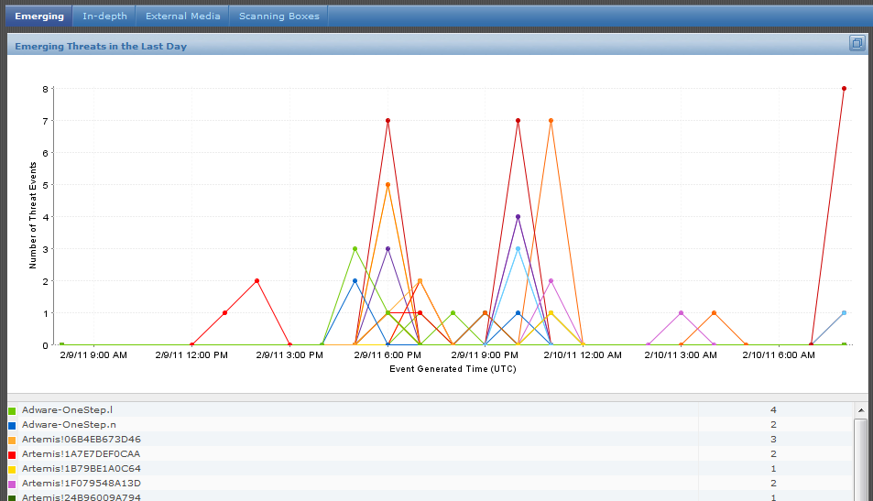
Emerging Threats

Slide 17
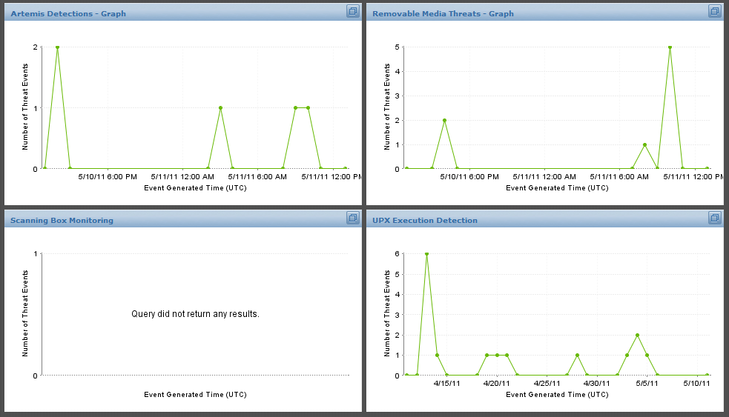
Dashboard-style reports

Slide 18
Identification
Service Desk
  Gathers as much information as possible to allow other groups to respond appropriately
    Infected computer moved to quarantined network
    Enquire about data/access on infected computer
    Network details gathered from Networking
    Initial ePO report generated
Notes:
BY whatever means a threat comes to our attention, the Service Desk…
CONFIRM THESE SUB-STEPS in CORRECT ORDER

Slide 19
Assessment
IT Security Group (ITSG) Triage
  Based on information gathered by the Service Desk ITSG classifies incident based on threat and possible PII exposure
  Classification determines response
Threat
PII
Response
Notes:
Critical, High, Minor/Low

Slide 20
Assessment
Critical – PII and unknown or known high risk malware involved
High – No PII but unknown or uncleanable malware involved
Medium – No PII, known cleanable malware involved

Slide 21
Investigation
Critical and High Incidents
  Computer retrieved for further examination
  Critical incidents have a forensic backup
  ITSG completes in-depth analysis
    Identifies suspect files, attack vector
    Suspect files provided to McAfee
    Estimates risk of PII or financial loss
    Communicates with department head and privacy office if significant breach suspected

Slide 22
Investigation
Medium Incidents
  Onsite visit by PC support, who conduct additional scans and gather log data
  Data collected is added to the incident log and assigned to ITSG for review, possible further instructions

Slide 23

It’s Butters
Butters is a Linux server developed for handling onsite visits and backups
  Infected computers are placed in
  quarantine VLAN 666 with Butters
  Allows PC support to connect to the
  server to retrieve tools and upload
  logs and quarantine files
    Eliminates USB risk
    Automatically pulls down latest definitions

Slide 24
Clean/Rebuild
Based on ITSG’s determination the infected computer will either be
  Cleaned and hardened
  Backed up and rebuilt from scratch
Standard backup and restore procedure modified for malware response
  No wholesale restores
  PC support works with client to identify files that can be safely restored

Slide 25
Resolution
ITSG reviews the incident and if everything is in order the computer is returned and/or networking restored
Service Desk follows up with client to ensure everything OK
One week following the return of the computer a follow-up ePO report is generated and reviewed by ITSG

Slide 26
New Technologies
New technologies implemented
  Windows Deployment Server to allow rapid rebuilds with consistent configuration
  Forensic imaging (where required)
    Clonezilla
  McAfee for Linux
    Used to screen files before restoring
    Removable media scanning stations

Slide 27
McAfee Site Advisor
SiteAdvisor was available to us in EPO
  Adds toolbar to a users browser and advises using content ratings.
  Provides warning page on high risk or sites with browser exploits, user can decide whether to continue
  Lots of reporting and can help determine sources of malware infections,
    For example, many people clicking the same link in a spam email

Slide 28
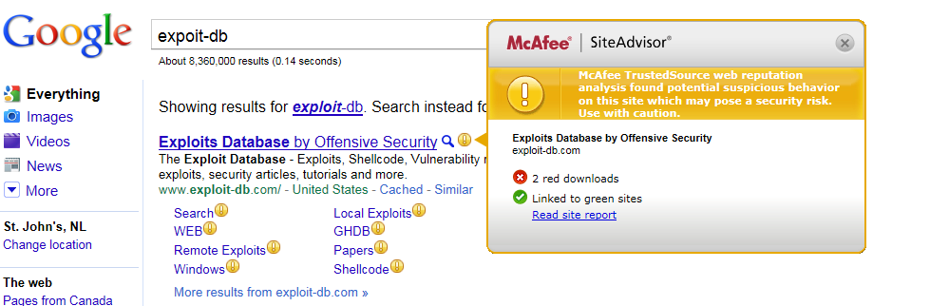
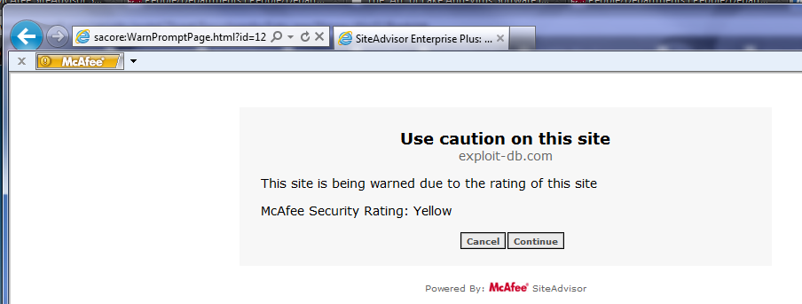
McAfee Site Advisor

Slide 29
Network Filtering
Anti-Botnet Filter
  Cisco ASA Firewall Add-on
    DNS-like lookups against blacklist
    Relatively inexpensive
    Detects/Blocks malicious connections
    Reporting leaves something to be desired

Slide 30
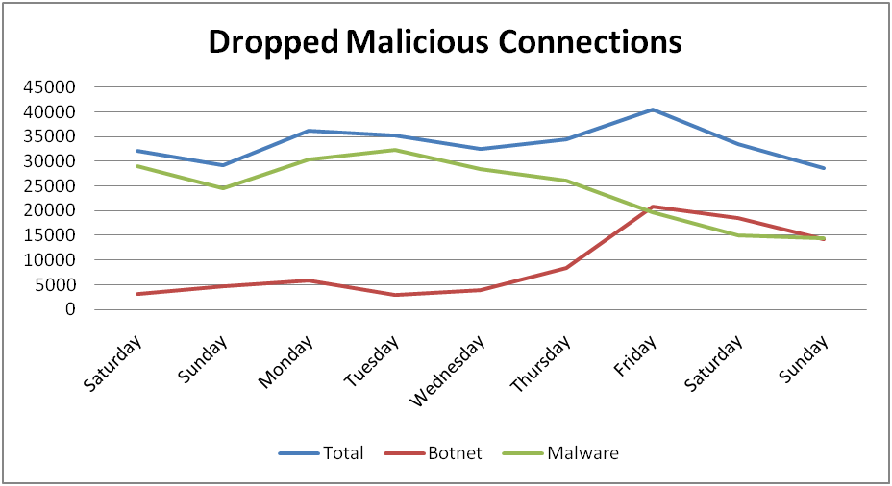
Network Filtering

Slide 31
Milestones
500+ virus incidents handled since Zeus
100+ samples sent to McAfee, resulting in dozens of new signatures
Rapid response - detection to action now typically less than 4 hrs
Resolution time gone from [worst case scenario] weeks to [worst case scenario]
< 5 days; typically 2-3 days

Slide 32
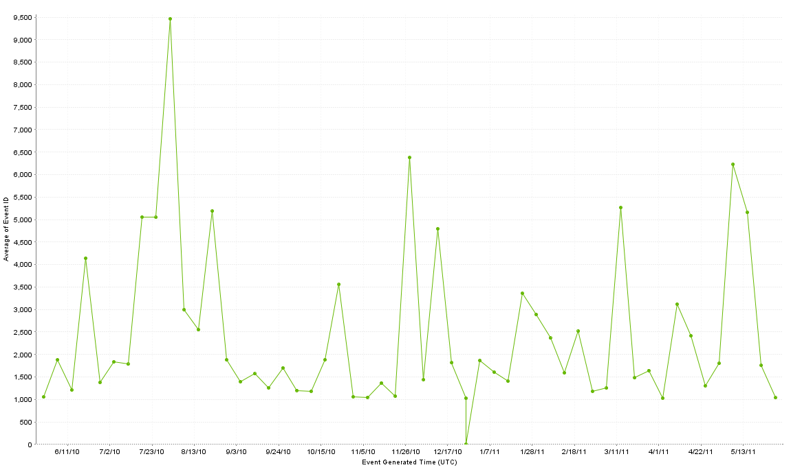
One Year of Malware
First Full Scans with Artemis
First Full Scans with Artemis
FakeAV
FakeAV
FakeAV
File-infector Viruses
File-infector Viruses
Java Exploits
Java Exploits
Yay! Holidays!

Slide 33
Conclusions
Malware a security incident, not break-fix
Requires pan-departmental response
Requires inter-departmental response
Took and still takes a lot of time
Justified given today’s malware

Slide 34
Discussion
Jared Perry, GSEC
jaredp@mun.ca
Memorial University

